Slide 1

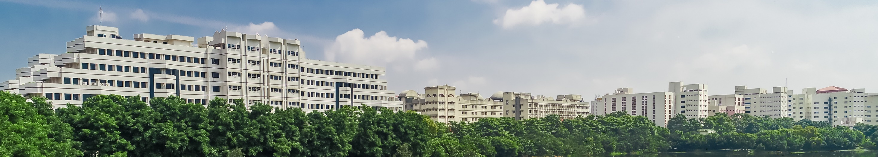
Model-Based Design and Simulation of a Semi-Active Suspension System for Two-Wheelers to Enhance Ride Comfort
Name:-Jashwanth S
School of Mechanical Engineering
Set Conference
Guide Name:
Dr. Rajesh Kanna, CO₂ Research and Green Technologies
Dr. Ramesh Kumar C, ARC
Review-II
Date of Presentation:

Slide 2
CONTENTS
Introduction
Literature Review
Problem Statement & Objectives
Methodology
System Modeling
Results
Conclusion

Slide 3
Introduction
The suspension system in two-wheelers must balance ride comfort, road grip, and handling stability, which is more challenging due to lighter chassis and limited suspension geometry.
Passive suspensions are commonly used in motorcycles which offer fixed damping and struggle to adapt across varying terrains and riding conditions.
Semi-active suspensions enhance traditional setups by enabling real-time damping control without requiring heavy or power-intensive actuators.
In this project i have created a mathematical model of bike suspension system in MATLAB/Simulink, integrating a PID-controlled damper with a Lookup Table for velocity-dependent damping adjustment.

Slide 4
Literature Review
Title of the paper | Journal & Year | Authors | Description | Remarks
Control and Simulation of Semi-Active Suspension System using PID Controller for Automobiles under LABVIEW Simulink. | International Journal of Current Engineering and Technology, Vol. 7, No. 5, Sept/Oct 2017 | Kareem Hassan, Asaad Ali Dammed | Developed a quarter-car model and implemented a PID-based semi-active suspension in LABVIEW/Simulink. Simulated system response under step and random road inputs to evaluate ride comfort. Demonstrated effectiveness of PID in reducing body displacement and oscillations compared to passive suspension. Highlighted the tuning process for PID gains as critical to achieving optimal damping performance. | Semi-active suspension with PID shows improved comfort and stability over passive suspension. Real-time application requires robust gain tuning to handle varying road disturbances.

Slide 5
Literature Review
Design and Optimization of a Semi-Active Suspension System for a Two-Wheeled Vehicle Using a Full Multibody Model | Proceedings of the IMechE, Part K: Journal of Multi-body Dynamics, 2016 | A. Khadr, A. Houidi, L. Romdhane | Developed a full multibody dynamics model of a motorcycle to capture realistic suspension and chassis behavior. Investigated semi-active suspension control strategies with variable damping for improved comfort and stability. Used optimization techniques to tune suspension parameters and controller gains under different riding conditions. Validated the model through simulation studies, highlighting the performance gains over passive suspension. | Demonstrated how multibody modeling provides more accurate insight than simplified models. Optimization-based design ensures adaptability across varying road conditions and speeds.
Modelling and Simulation of Semi-Active Suspension System for Passenger Vehicle | Journal of Engineering Science and Technology, 2018 | M.Farid Aladdin, Jasdeep Singh | Developed a simulation model for a semi-active suspension system applied to a passenger vehicle. Utilized a 2-DOF Quarter-Car model to analyze vehicle dynamic response to road disturbances. Implemented and compared control strategies, focusing on the Skyhook algorithm to regulate damping force. Evaluated performance using key metrics like vehicle body acceleration and suspension deflection. | Clearly demonstrates the effectiveness of the Skyhook control strategy in improving ride comfort over a passive system. The study is limited by the simplicity of the Quarter-Car model, which does not account for full vehicle pitch and roll motions or tire dynamics.

Slide 6

Knowledge gained from Literature
Semi-active suspension systems with PID control can significantly improve ride comfort compared to passive suspensions.
Simulation tools like MATLAB/Simulink and LABVIEW are widely used for modeling and controller validation.
Both quarter-car and multibody models help understand suspension dynamics, but model selection impacts accuracy.
Suspension performance depends heavily on controller design and tuning, influencing stability and comfort trade-offs.
Studies highlight the importance of road profile inputs in evaluating suspension effectiveness under real conditions.

Slide 7
Problem Statement And Objectives
Traditional passive suspensions in two-wheelers are limited by fixed damping properties, making them ineffective across diverse road conditions and speeds.
Active suspension systems, though highly responsive, are often costly, power-intensive, and complex, making them impractical for compact two-wheelers.
There is a need for a lightweight, energy-efficient, and adaptive suspension solution that can improve ride comfort and handling without excessive complexity.
Objectives
To develop a mathematical suspension model for a two-wheeler using MATLAB/Simulink.
To implement a semi-active suspension system using a PID controller that adapts damping based on road input and velocity.
To compare the ride comfort and performance of passive vs. semi-active systems under different conditions.

Slide 8
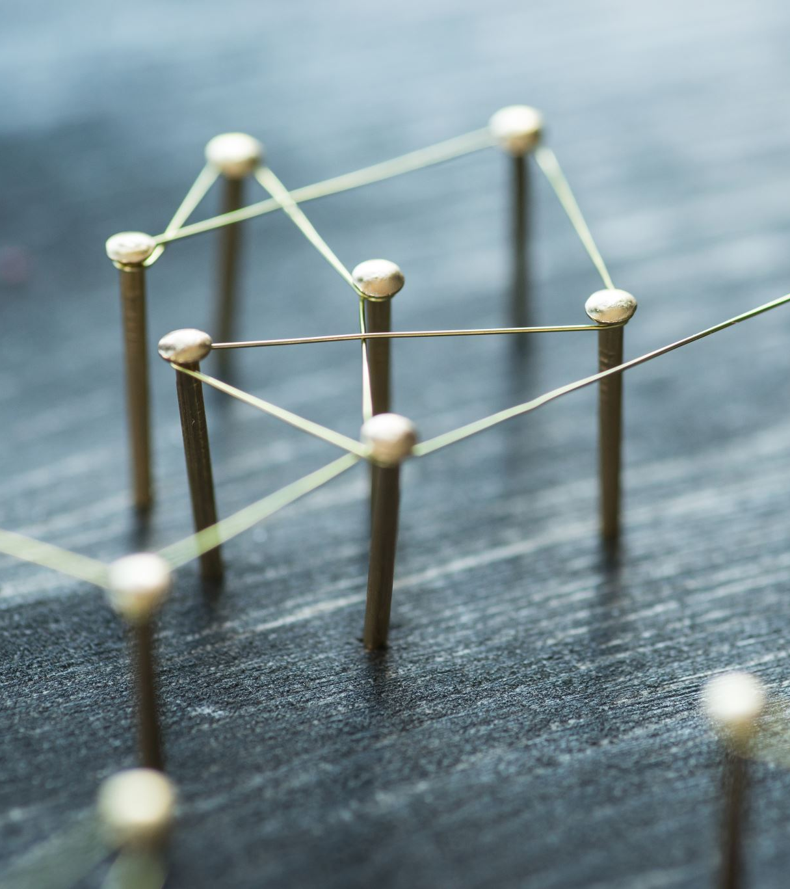
Methodology
Selection of Topic
Literature Review
Problem Definition & Objective
Passive system modeling and Semi-active system modeling using Simulink
Control Strategy: Implement PID Controller to regulate damping force.
Performance Evaluation
Compare passive vs semi-active suspension.

Slide 9
Assumptions
The two-wheeler is represented by a 2-DOF vehicle model (sprung and unsprung masses).
Only vertical dynamics are considered (no pitch, roll, or lateral effects).
Suspension & Tire Suspension spring is linear with constant stiffness
No time delay or actuator dynamics are considered.
Sprung mass represents rider + vehicle body.
Unsprung mass represents wheel + assembly.
Aerodynamic forces are ignored
Nonlinearities in suspension geometry (linkages, bushings) are ignored.
Thermal effects in damper are neglected.
Rider posture and variability are not included.

Slide 10
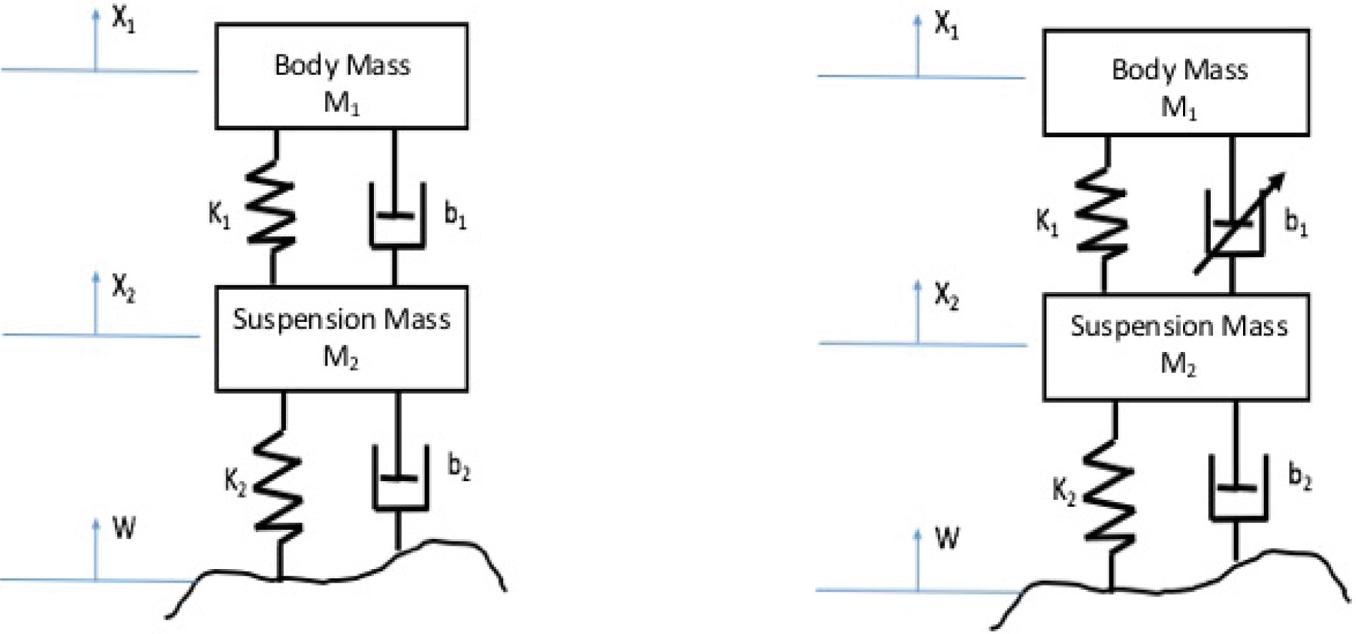
Passive Suspension System Modleing
where:
M1 = Sprung mass (kg) = 180 kg
M2 = Un-sprung mass (kg) = 20 kg
x1 = Body mass Displacement (m)
x2 = Suspension mass Displacement (m)
b1 = Suspension damping coefficient (N.s/m) = 1306 N.s/m
b2 = Tyre damping coefficient (N.s/m) = 800 N.s/m
k1 = Suspension spring coefficient (N/m) = 30000 N/m
k2 = Tyre spring coefficient (N/m) = 10000 N/m
W = Road profile
Fig 1: Passive suspension system model

Slide 11
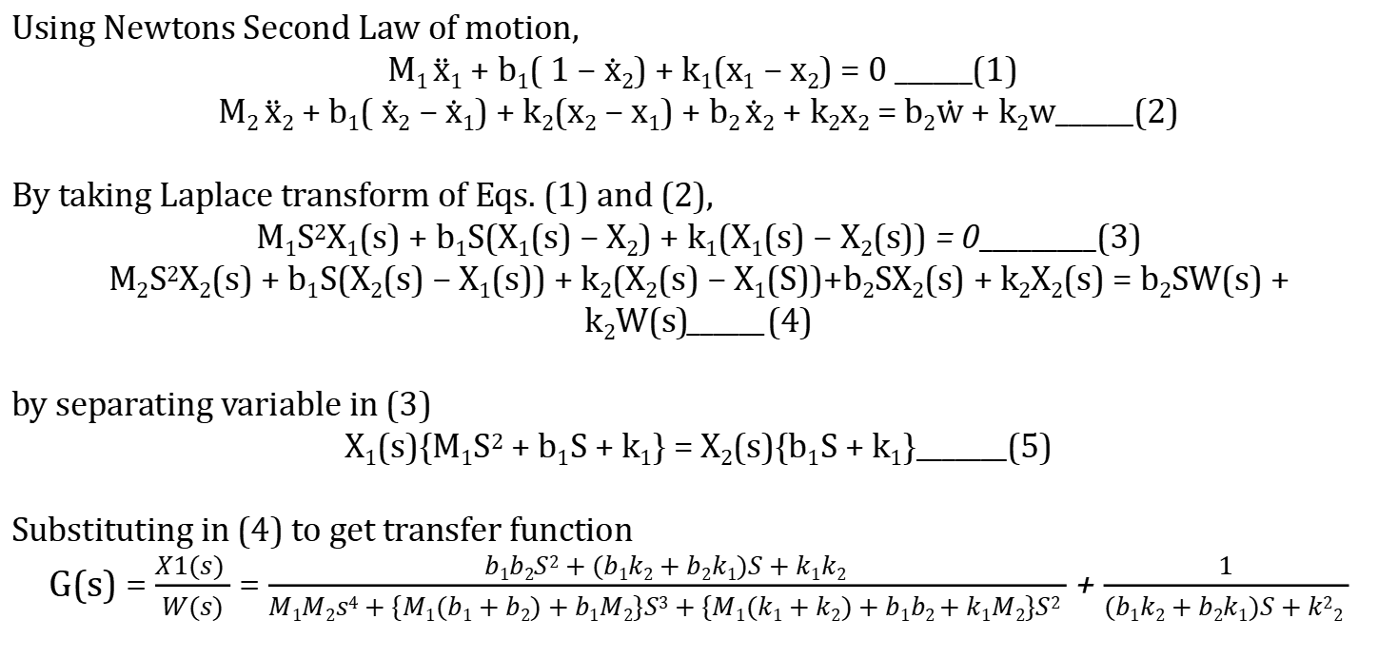
Mathematical Equation
Using Newtons Second Law of motion,
M₁ $\ddot{x}$₁ + b₁( 1 − $\dot{x}2$) + k₁(x₁ − x₂) = 0 ______(1)
M₂ $\ddot{x}$₂ + b₁( $\dot{x}2$ − $\dot{x}$₁) + k₂(x₂ − x₁) + b₂ $\dot{x}$₂ + k₂x₂ = b₂$\dot{w}$ + k₂w______(2)
By taking Laplace transform of Eqs. (1) and (2),
M₁S²X₁(s) + b₁S(X₁(s) − X₂) + k₁(X₁(s) − X₂(s)) = 0_________(3)
M₂S²X₂(s) + b₁S(X₂(s) − X₁(s)) + k₂(X₂(s) − X₁(S))+b₂SX₂(s) + k₂X₂(s) = b₂SW(s) + k₂W(s)______(4)
by separating variable in (3)
X₁(s){M₁S² + b₁S + k₁} = X₂(s){b₁S + k₁}_______(5)
Substituting in (4) to get transfer function
G(s) = $\frac{X1(s) }{W(s)}$ = $\frac{b1b2S2 + (b1k2 + b2k1)S + k1k2 }{M1M2s4 + \{M1(b1 + b2) + b1M2\}S3 + \{M1(k1 + k2) + b1b2 + k1M2\}S2 }$ + $\frac{1}{(b1k2 + b2k1)S + k22 }$

Slide 12
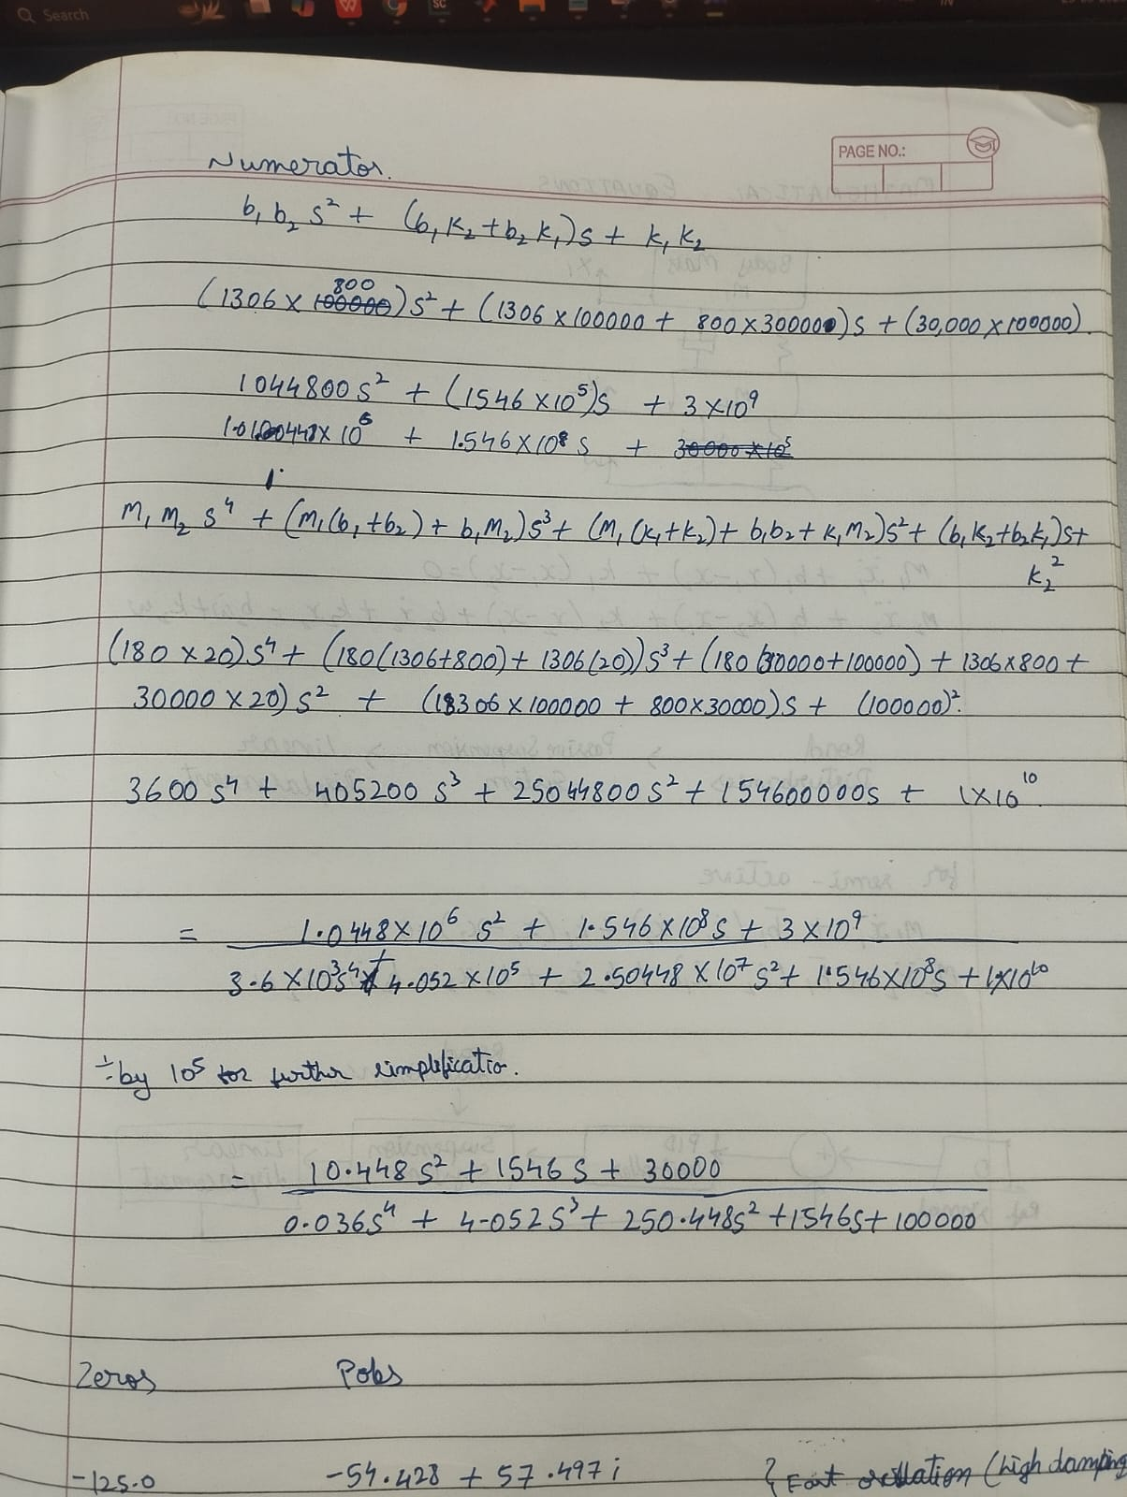
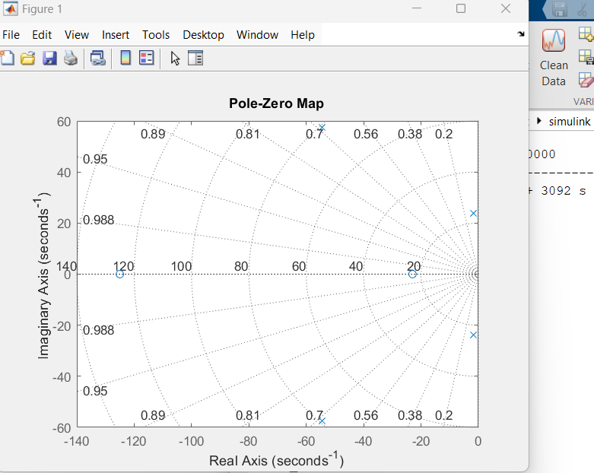
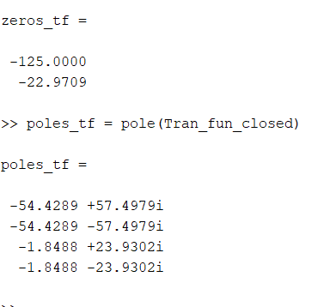
System Stability Analysis Of Model

Slide 13
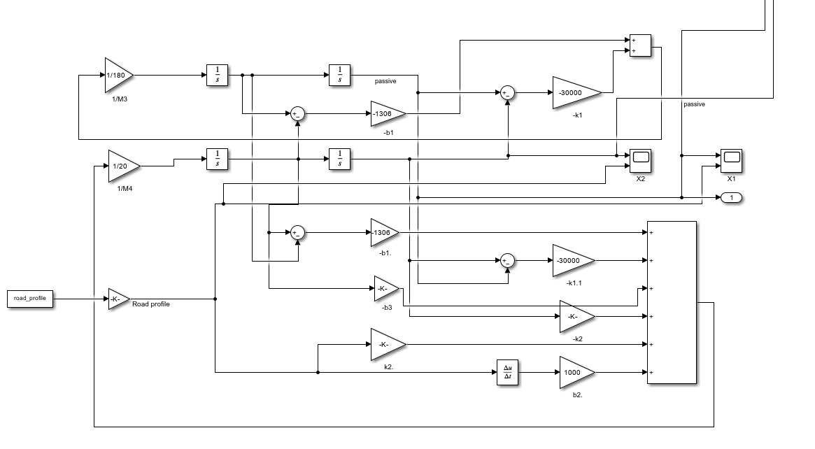
Simulink model of Passive suspension system
Fig:2: Simulink Model of Passive Suspension Control System

Slide 14
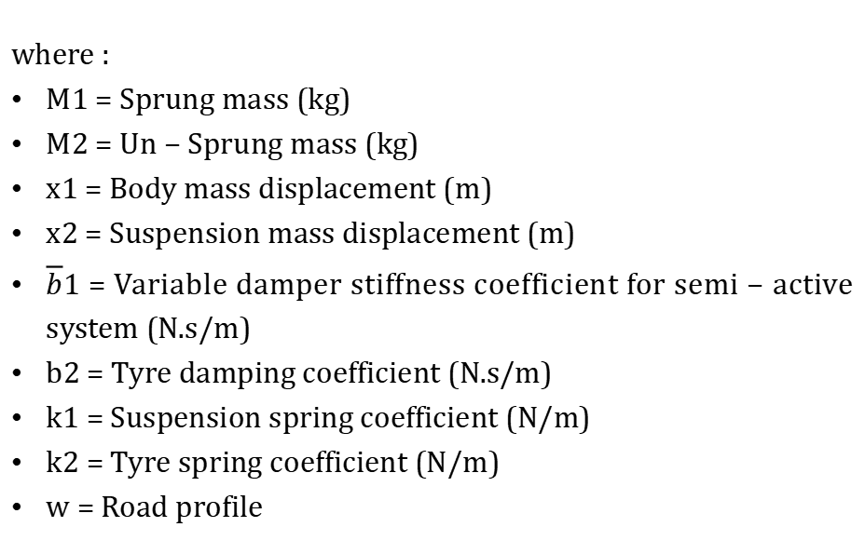
Semi Active Suspension System Model
where :
M1 = Sprung mass (kg)
M2 = Un − Sprung mass (kg)
x1 = Body mass displacement (m)
x2 = Suspension mass displacement (m)
$\overline{b}$1 = Variable damper stiffness coefficient for semi − active system (N.s/m)
b2 = Tyre damping coefficient (N.s/m)
k1 = Suspension spring coefficient (N/m)
k2 = Tyre spring coefficient (N/m)
w = Road profile
Fig 3: Semi-active suspension system model

Slide 15
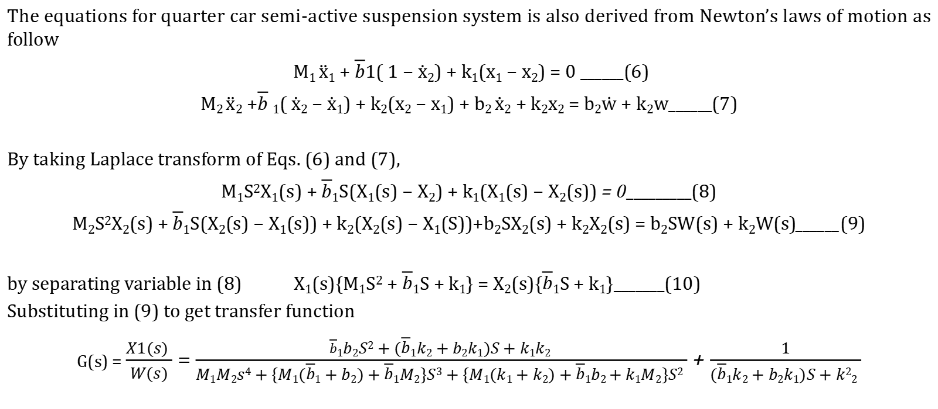
Mathematical equation
The equations for quarter car semi-active suspension system is also derived from Newton’s laws of motion as follow
M₁ $\ddot{x}$₁ + $\overline{b}$1( 1 − $\dot{x}2$) + k₁(x₁ − x₂) = 0 ______(6)
M₂ $\ddot{x}$₂ +$\overline{b}$ ₁( $\dot{x}2$ − $\dot{x}$₁) + k₂(x₂ − x₁) + b₂ $\dot{x}$₂ + k₂x₂ = b₂$\dot{w}$ + k₂w______(7)
By taking Laplace transform of Eqs. (6) and (7),
M₁S²X₁(s) + $\overline{b}$₁S(X₁(s) − X₂) + k₁(X₁(s) − X₂(s)) = 0_________(8)
M₂S²X₂(s) + $\overline{b}$₁S(X₂(s) − X₁(s)) + k₂(X₂(s) − X₁(S))+b₂SX₂(s) + k₂X₂(s) = b₂SW(s) + k₂W(s)______(9)
by separating variable in (8) X₁(s){M₁S² + $\overline{b}$₁S + k₁} = X₂(s){$\overline{b}$₁S + k₁}_______(10)
Substituting in (9) to get transfer function
G(s) = $\frac{X1(s) }{W(s)}$ = $\frac{\overline{b}1b2S2 + (\overline{b}1k2 + b2k1)S + k1k2 }{M1M2s4 + \{M1(\overline{b}1 + b2) + \overline{b}1M2\}S3 + \{M1(k1 + k2) + \overline{b}1b2 + k1M2\}S2 }$ + $\frac{1}{(\overline{b}1k2 + b2k1)S + k22 }$

Slide 16
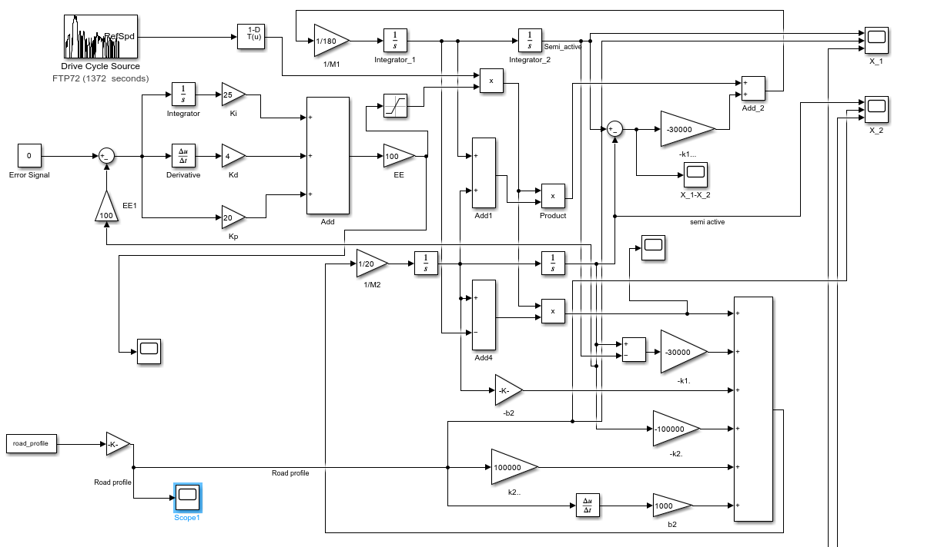
Simulink Model of Semi-Active Suspension System
Fig 4: Simulink Model of Semi-Active Suspension Control System

Slide 17
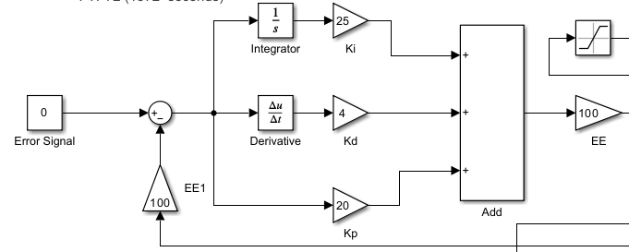
PID Controller
Fig 5: PID Controller
Kp (Proportional)=20: Controls the present error - determines the reaction to the current error.
Ki (Integral)=25: Controls the past error - eliminates steady-state error by accumulating past errors.
Kd (Derivative)=4: Controls the future error - predicts future behavior and reduces overshoot.

Slide 18
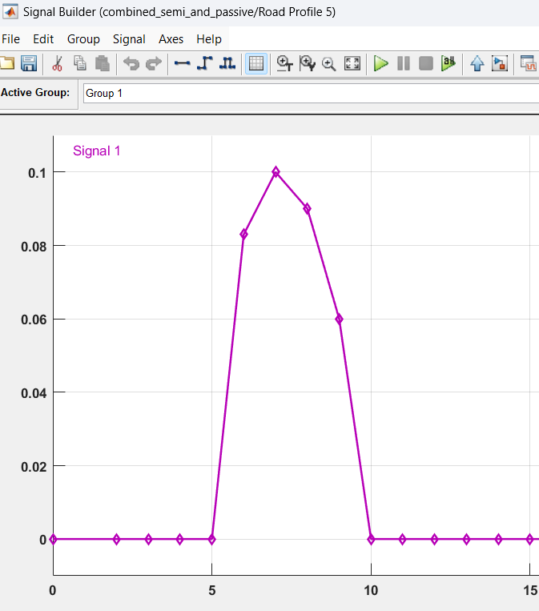
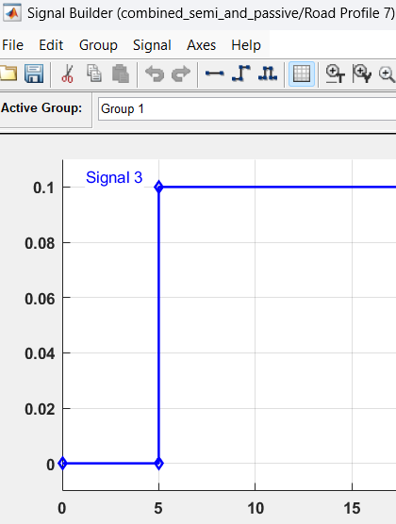
Road Profile (Input)
Fig. 5: Road disturbance profile-1
Fig. 9: Road disturbance profile-2

Slide 19
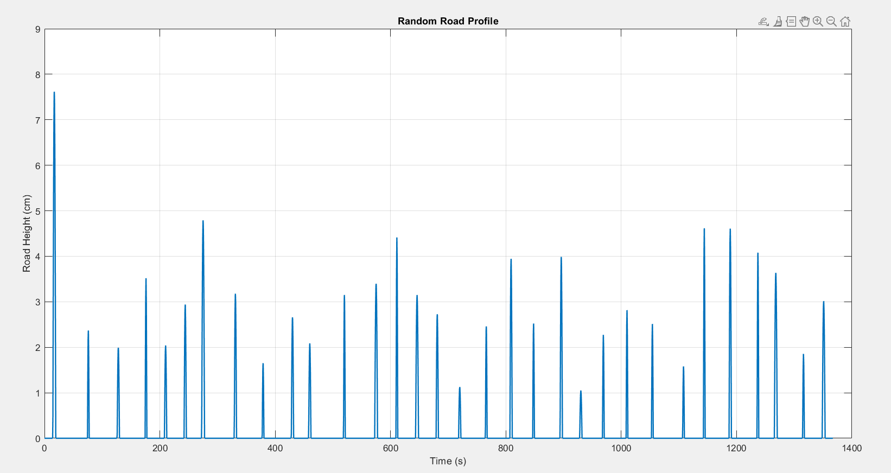
Road Profile (Input)
Fig. 7: Random Road disturbance profile

Slide 20

Results & Discussion

Slide 21
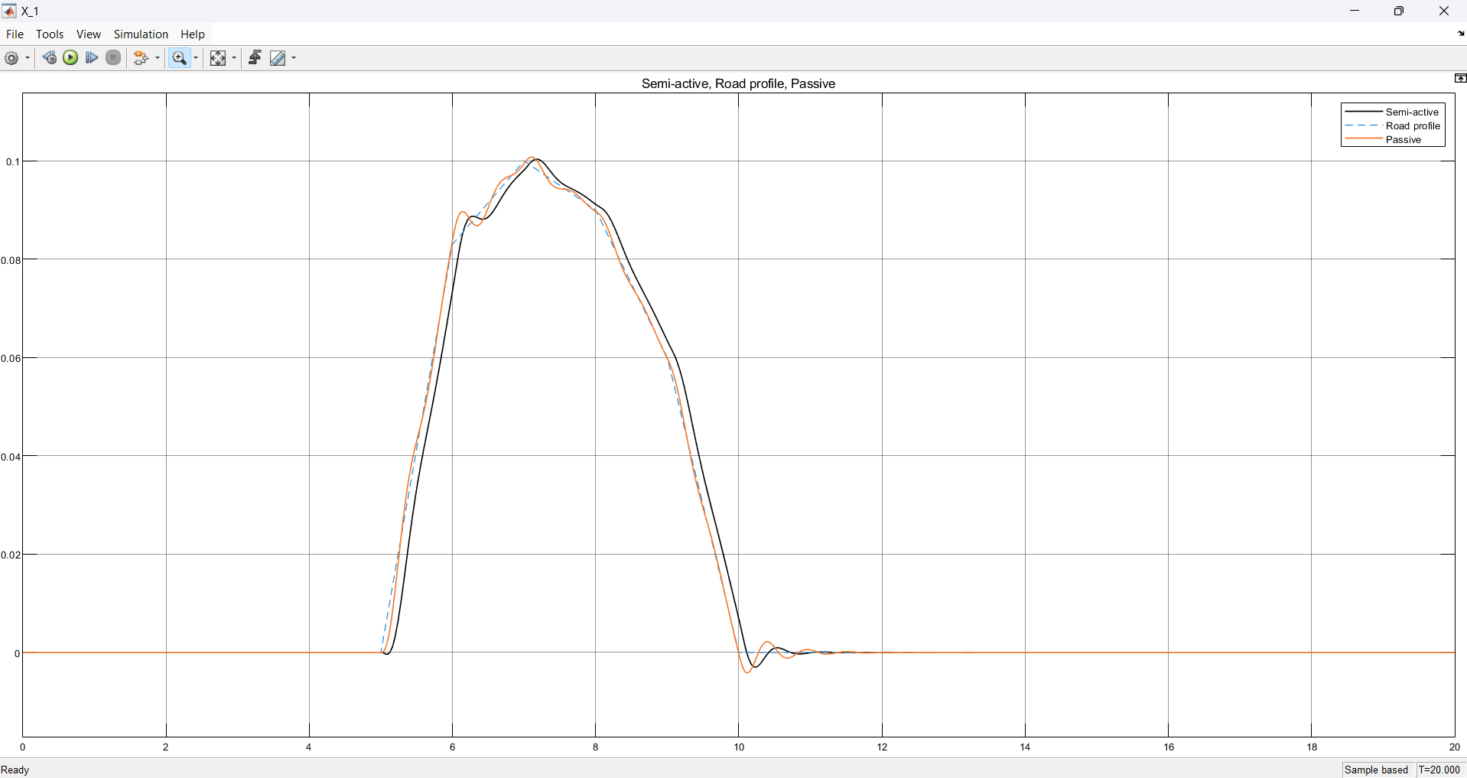
Results
Fig 8: Sprung Mass Response for Road Profile-1

Slide 22
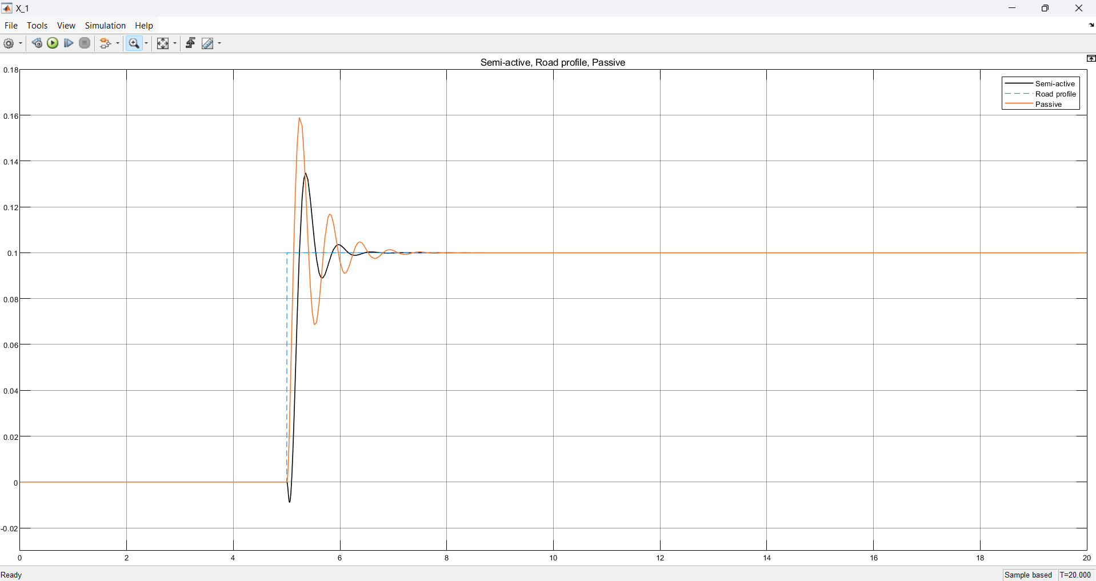
Results
Fig 9: Sprung Mass Response for Road Profile-2

Slide 23
Results
Metric | Road Profile | Passive (P) | Semi-active (SA) | Improvement (SA vs P)
Peak Overshoot | Profile 1 | 0.108 m | 0.104 m | Reduced by ~3%
 | Profile 2 | 0.16 m | 0.13 m | Reduced by~20%
Rise Time (Tr) | Profile 1 | 1.58 s | 1.40 s | Reduced by~11.4%
 | Profile 2 | 0.58 s | 0.42 s | Reduced by~27.6%
Settling Time (Ts) | Profile 1 | 1.9 s | 1.3 s | Settled ~22%quicker
 | Profile 2 | 2.4 s | 1.8 s | Settled ~25%quicker
Table 1. Comparison of Sprung Mass Displacement(x1) for passive and semi-active suspension system

Slide 24
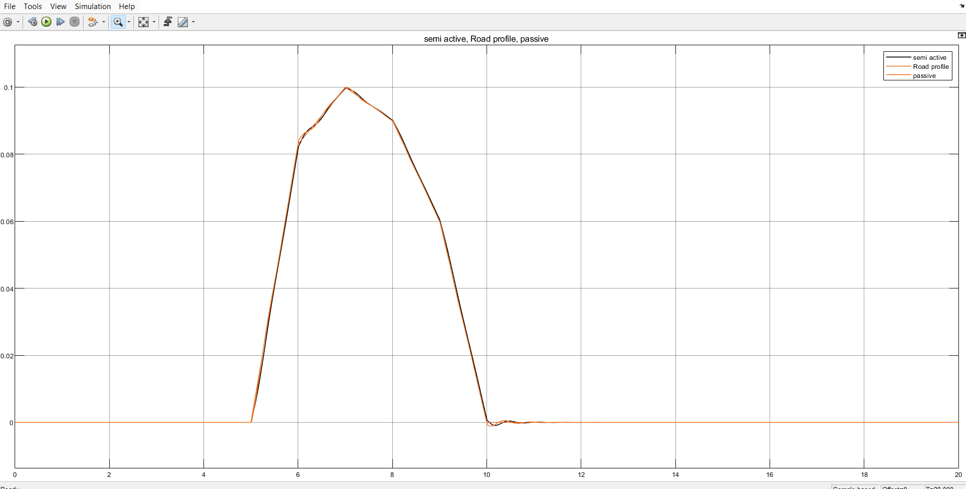
Results
Fig 10: Un-Sprung Mass Response for Road Profile-1

Slide 25
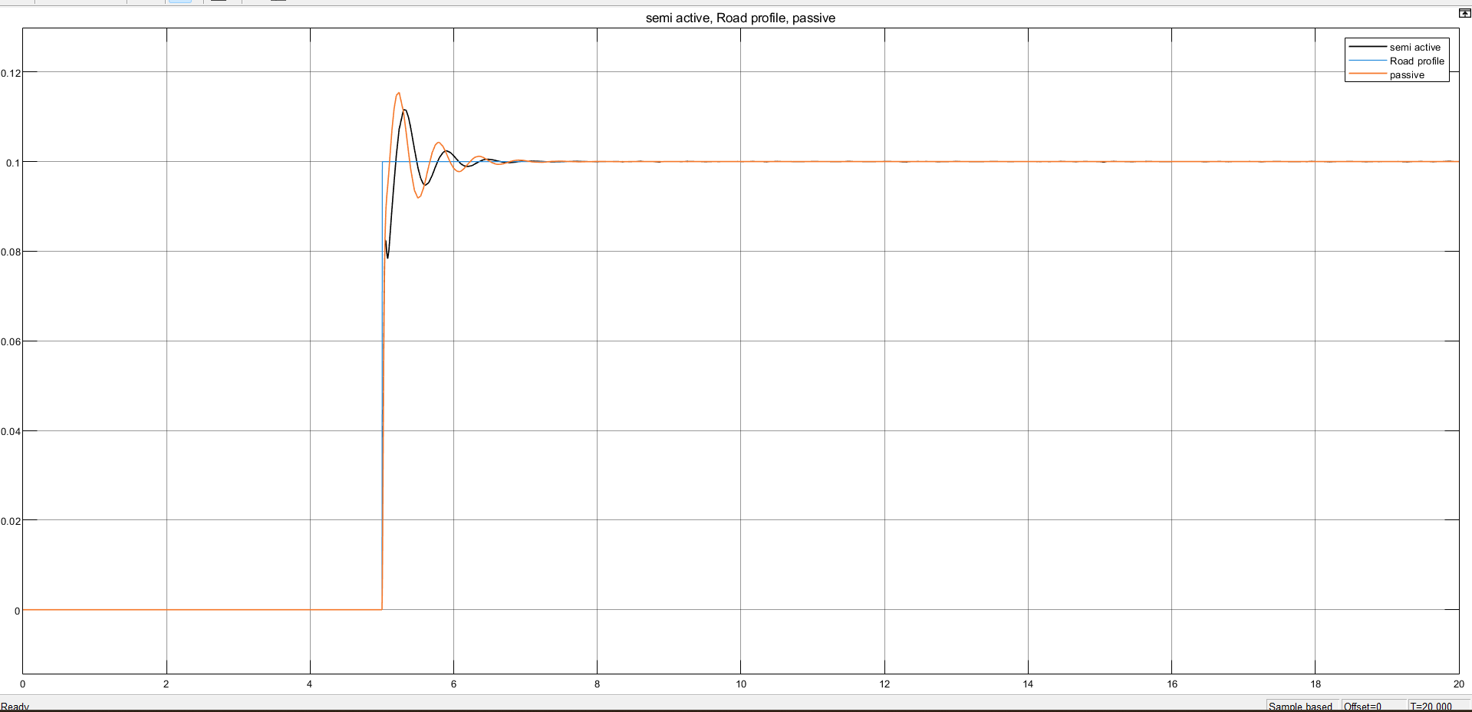
Results
Fig 11: Un-Sprung Mass Response for Road Profile-2

Slide 26
Results
Metric | Road Profile | Passive (P) | Semi-active (SA) | Improvement (SA vs P)
Peak Overshoot | Profile 1 | 0.1 | 0.097 | Reduced by ~3%
 | Profile 2 | 0.116 | 0.108 | Reduced by~7%
Rise Time (Tr) | Profile 1 | 1.71 | 1.25 | Reduced by~26%
 | Profile 2 | 0.31 | 0.25 | Reduced by~16.6%
Settling Time (Ts) | Profile 1 | 1.87 | 1.48 | Settled ~20%quicker
 | Profile 2 | 2.3 | 1.86 | Settled ~21%quicker
Table 2. Comparison of Un-Sprung Mass Displacement(x2) for passive and semi-active suspension system

Slide 27
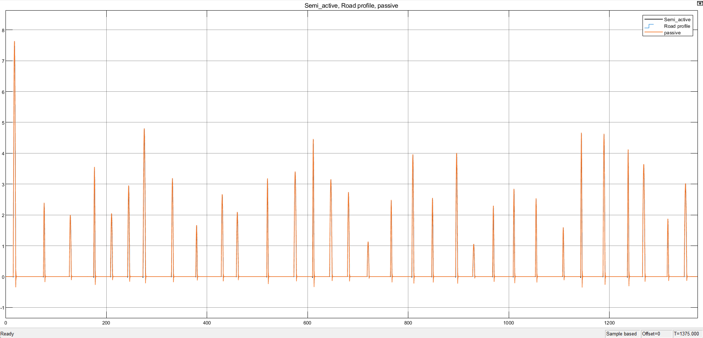
Results
Fig 12: Response of the System for Random Road Profile and Velocity(FTP75 drive cycle)

Slide 28
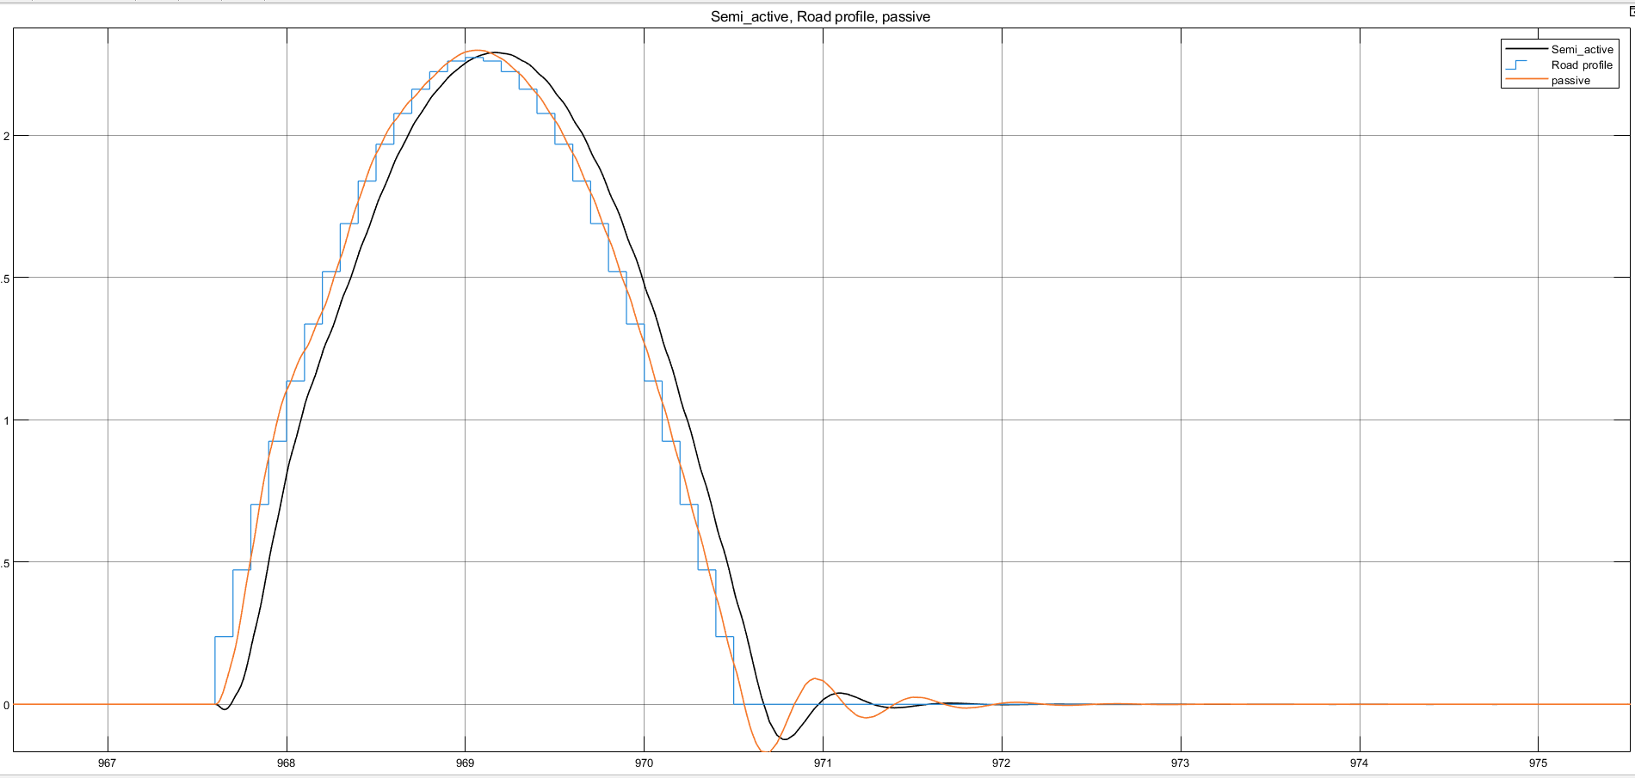
Results
Fig 13: Response of the System for Rand Road Profile at 10m/s (FTP75 drive cycle)

Slide 29
Results
Metric | Road Profile | Passive (P) | Semi-active (SA) | Improvement (SA vs P)
Peak Overshoot | Profile 1 | 2.45 | 2.41 | Reduced by ~1.8%
Rise Time (Tr) | Profile 1 | 1.48 | 1.35 | Reduced by~9%
Settling Time (Ts) | Profile 1 | 2.42 | 1.84 | Settled ~24%quicker
Table 3. Comparison of Sprung Mass Displacement(x) for passive and semi-active suspension system at 10m/s (968sec)

Slide 30
Conclusions
Semi-active suspension system with PID control significantly improves ride comfort compared to passive systems by reducing overshoot and settling time.
The PID-controlled damping allows real-time adaptability to road conditions, minimizing body oscillations effectively.
Simulation results for different road profiles demonstrate faster response and greater stability in the semi-active system without added actuator complexity.
The project validates the feasibility of implementing a semi-active system using MATLAB/Simulink and encourages future work on self-tuning PID, Fuzzy logic controller or adaptive control strategies.

Slide 31
References
[1] H. Sanmotra, B. Dubey, and S. Giri, Designing PID Controller Based Semi-active Suspension System Using MATLAB Simulink, Final Project Report, MECH 6021 – Design of Industrial Control Systems, Concordia University, Dec. 6, 2021.
[2] K. Hassan and A. A. Dammed, “Control and Simulation of Semi-Active Suspension System using PID Controller for Automobiles under LABVIEW Simulink,” International Journal of Mechanical Engineering and Technology (IJMET).
[3] M. Jamil, S. Zafar, and S. O. Gilani, “Design and Control of Semi-Active Suspension System using PID in MATLAB Simulink,” Lecture Notes in Electrical Engineering, vol. 837, pp. 275–289, 2022.
[4] Mouad, G. Abdelmjid, S. Modelling and Control of a Semi-active Suspension System of Motorcycle. Conference Paper · December 2018
[5] Khadr1, A. Design and optimization of a semi-active suspension system for a two-wheeled vehicle using a full multibody model. sagepub.co.uk/journalsPermissions.nav
[6] Cristiano Spelta, Sergio M. Savaresi, Luca Fabbri (2010). Experimental analysis of a motorcycle semi-active rear suspension. Control Engineering Practice, 18(11), 1239-1250.

Slide 32
References
[7] Rao, K. D. (2014). Modeling, simulation and control of semi-active suspension system for automobiles under MATLAB Simulink using PID controller. In Proceedings of the Third International Conference on Advances in Control and Optimization of Dynamical Systems (pp. 827-831). Kanpur, India.
[8] Abramov, S., Mannan, S., & Durieux, O. (2009). Semi-active suspension system simulation using Simulink. International Journal of Engineering Systems Modelling and Simulation, 1(2/3), 101-114.
[9] Aladdin, M. F., & Singh, J. (2018). Modelling and simulation of semi-active suspension system for passenger vehicle. Journal of Engineering Science and Technology, 7th EURECA 2016 Special Issue, 104-125. Taylor’s University.
[10] Sanap, P. P., & Mali, M. S. (2017). A review paper on design, analysis & performance evaluation of semi-active monosuspension system for two wheelers. International Journal of Scientific & Engineering Research, 8(4), 164-175. ISSN 2229-5518.
[11] Walavalkar, S., Tandel, V., Thakur, R. S., Kumar, V. P., & Bhuran, S. (2021). Performance comparison of various controllers on semi-active vehicle suspension system. ITM Web of Conferences, 40, 01001.

Slide 33
THANK YOU

